Slide 1
Boolean Algebra and Logic Simplification
Part 1
Course : CPEN6265010 Digital System
Effective Period : September 2025

Slide 2
Related LO
Learning Objectives
LO1: Analyze and Design Combinational Logic Circuits.

Slide 3
Outlines
Boolean Operations and Expressions
Laws and Rules of Boolean Algebra
DeMorgan’s Theorems

Slide 4
Boolean Operations and Expressions
In Boolean algebra, a variable is a symbol used to represent an action, a condition, or data. A single variable can only have a value of 1 or 0.
The complement represents the inverse of a variable and is indicated with an overbar. Thus, the complement of A is A.
A literal is a variable or its complement.
Addition is equivalent to the OR operation. The sum term is 1 if one or more if the literals are 1. The sum term is zero only if each literal is 0.
Example
Determine the values of A, B, and C that make the sum term of the expression A + B + C = 0?
Solution
Each literal must = 0; therefore A = 1, B = 0 and C = 1.

Slide 5
Boolean Operations and Expressions
In Boolean algebra, multiplication is equivalent to the AND operation. The product of literals forms a product term. The product term will be 1 only if all of the literals are 1.
Example
What are the values of the A, B and C if the product term of A.B.C = 1?
Solution
Each literal must = 1; therefore A = 1, B = 0 and C = 0.

Slide 6
Laws and Rules of Boolean Algebra
Commutative Laws of addition & multiplication
Associative Laws of addition & multiplication
Distributive Law
Twelve basic rules of Boolean Algebra

Slide 7
Laws and Rules of Boolean Algebra
The commutative laws are applied to addition and multiplication. For addition, the commutative law states
In terms of the result, the order in which variables are ORed makes no difference.
A + B = B + A
For multiplication, the commutative law states
In terms of the result, the order in which variables are ANDed makes no difference.
AB = BA

Slide 8
Laws and Rules of Boolean Algebra
The associative laws are also applied to addition and multiplication. For addition, the associative law states
When ORing more than two variables, the result is the same regardless of the grouping of the variables.
A + (B +C) = (A + B) + C
For multiplication, the associative law states
When ANDing more than two variables, the result is the same regardless of the grouping of the variables.
A(BC ) = (AB)C

Slide 9
Laws and Rules of Boolean Algebra
The distributive law is the factoring law. A common variable can be factored from an expression just as in ordinary algebra. That is
AB + AC = A(B+ C)
The distributive law can be illustrated with equivalent circuits:
A(B+ C)
AB + AC

Slide 10
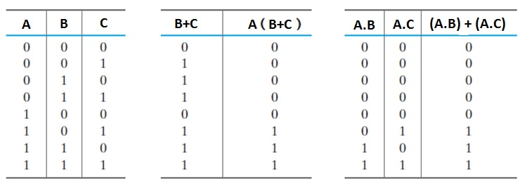
Laws and Rules of Boolean Algebra
Proof that :
A + B.C = (A+B).(A+C)

Slide 11
Laws and Rules of Boolean Algebra
1. A + 0 = A
7. A . A = A
2. A + 1 = 1
8. A . A = 0
=
3. A . 0 = 0
9. A = A
4. A . 1 = A
10. A + AB = A
5. A + A = A
11. A + AB = A + B
6. A + A = 1
12. (A + B)(A + C) = A + BC

Slide 12
Laws and Rules of Boolean Algebra
Rules of Boolean algebra can be illustrated with Venn diagrams. The variable A is shown as an area.
The rule A + AB = A can be illustrated easily with a diagram. Add an overlapping area to represent the variable B.
The overlap region between A and B represents AB.
=
The diagram visually shows that A + AB = A. Other rules can be illustrated with the diagrams as well.

Slide 13
Laws and Rules of Boolean Algebra
Illustrate the rule with a Venn diagram.
Example
A + AB = A + B
Solution
This time, A is represented by the blue area and B again by the red circle.
The intersection represents AB.
Notice that A + AB = A + B
A

Slide 14
Laws and Rules of Boolean Algebra
Three areas represent the variables A, B, and C.
The area representing A + B is shown in yellow.
The area representing A + C is shown in red.
The overlap of red and yellow is shown in orange.
The overlapping area between B and C represents BC.
ORing with A gives the same area as before.
=
(A + B)(A + C)
A + BC

Slide 15
DeMorgan’s Theorems
DeMorgan’s 1st Theorem
The complement of a product of variables is equal to the sum of the complemented variables.
AB = A + B
Applying DeMorgan’s first theorem to gates:

Slide 16
DeMorgan’s Theorems
DeMorgan’s 2nd Theorem
The complement of a sum of variables is equal to the product of the complemented variables.
A + B = A . B
Applying DeMorgan’s second theorem to gates:

Slide 17
DeMorgan’s Theorems
Example
Apply DeMorgan’s theorem to remove the overbar covering both terms from the
expression X = C + D.
Solution
To apply DeMorgan’s theorem to the expression, you can break the overbar covering both terms and change the sign between the terms. This results in
X = C . D. Deleting the double bar gives X = C . D.
=

Slide 18
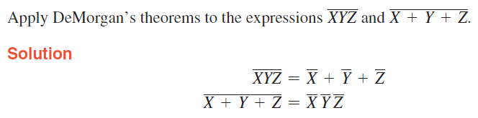
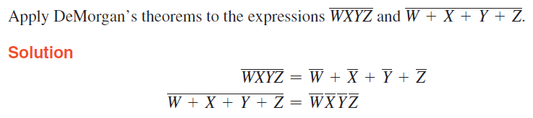

DeMorgan’s Theorems
Example

Slide 19
Exercise
Using Boolean notation, write an expression that is a 0 only when all of its variables (A, B, C, and D) are 0s.
Draw the logic circuit represented by each of the following expressions:
(a) A + B + C + D (b) ABCD
(c) A + BC (d) ABC + D
If you are required to choose a type of digital display for low light conditions, will you select LED or LCD 7-segment displays? Why?

Slide 20
References
Null, Linda (2024). "The essentials of computer organization and architecture". 6th edition. Jones & Bartlett Learning, Burlington, Massachusetts. ISBN: 9781284259438..
Thomas L. Floyd. (2014). “Digital Fundamentals”. 11th Edition. Prentice Hall. New Jersey. ISBN: 978-0132737968.
Introduction to K-Map: https://www.geeksforgeeks.org/introduction-of-k-map-karnaugh-map/
Karnaugh Maps, Truth Tables, and Boolean Expressions: https://www.allaboutcircuits.com/textbook/digital/chpt-8/karnaugh-maps-truth-tables-boolean-expressions/

